Slide 1
What is Machine Learning?
Data
Train
Model
Validate
Model
Make Predictions
Validate
Results
Notes:
Machine learning is a great way to conduct large-scale exploration of materials.

Slide 2
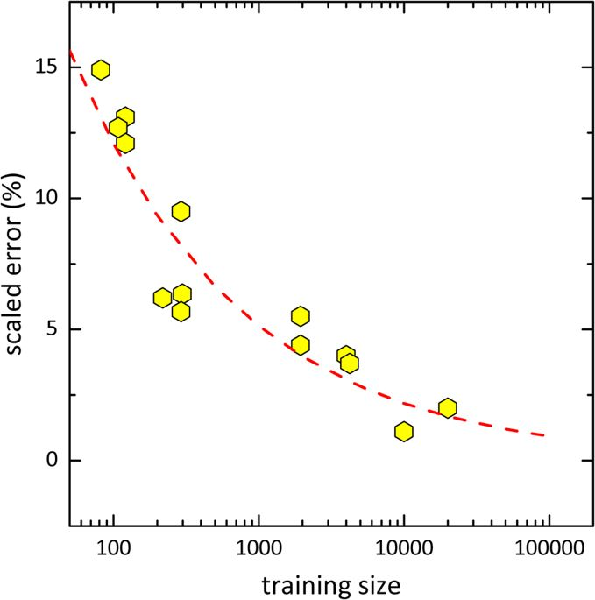
Benefits/Limitations of Machine Learning
Applying machine learning techniques can greatly reduce the time required to discover new materials
Adding more samples to the data set can be costly
Maximum accuracy of a prediction will always have a limit
Machine learning on its own cannot create/discover new Scientific Significance
Survey of scaled error and the size of training set in recent publications.
Source: Ying Zhang, Chen Ling. A strategy to apply machine learning to small datasets in materials science. npj Computational Materials, 2018

Slide 3
Role of Machine Learning
Time
Accuracy
Cost
Experiments
Validation
Input
Computational Modeling
Machine Learning

Slide 4
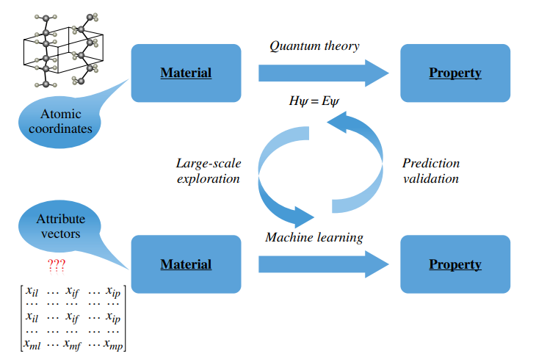

How We Used Machine Learning + Density Functional Theory
Took a summer to get 600 data points
Data Features
Hours to generate a 1000+ new data points
Kernel Ridge Regression
p^{b}: property of material
Notes:
Machine learning is a great way to conduct large-scale exploration of materials.

